Slide 1
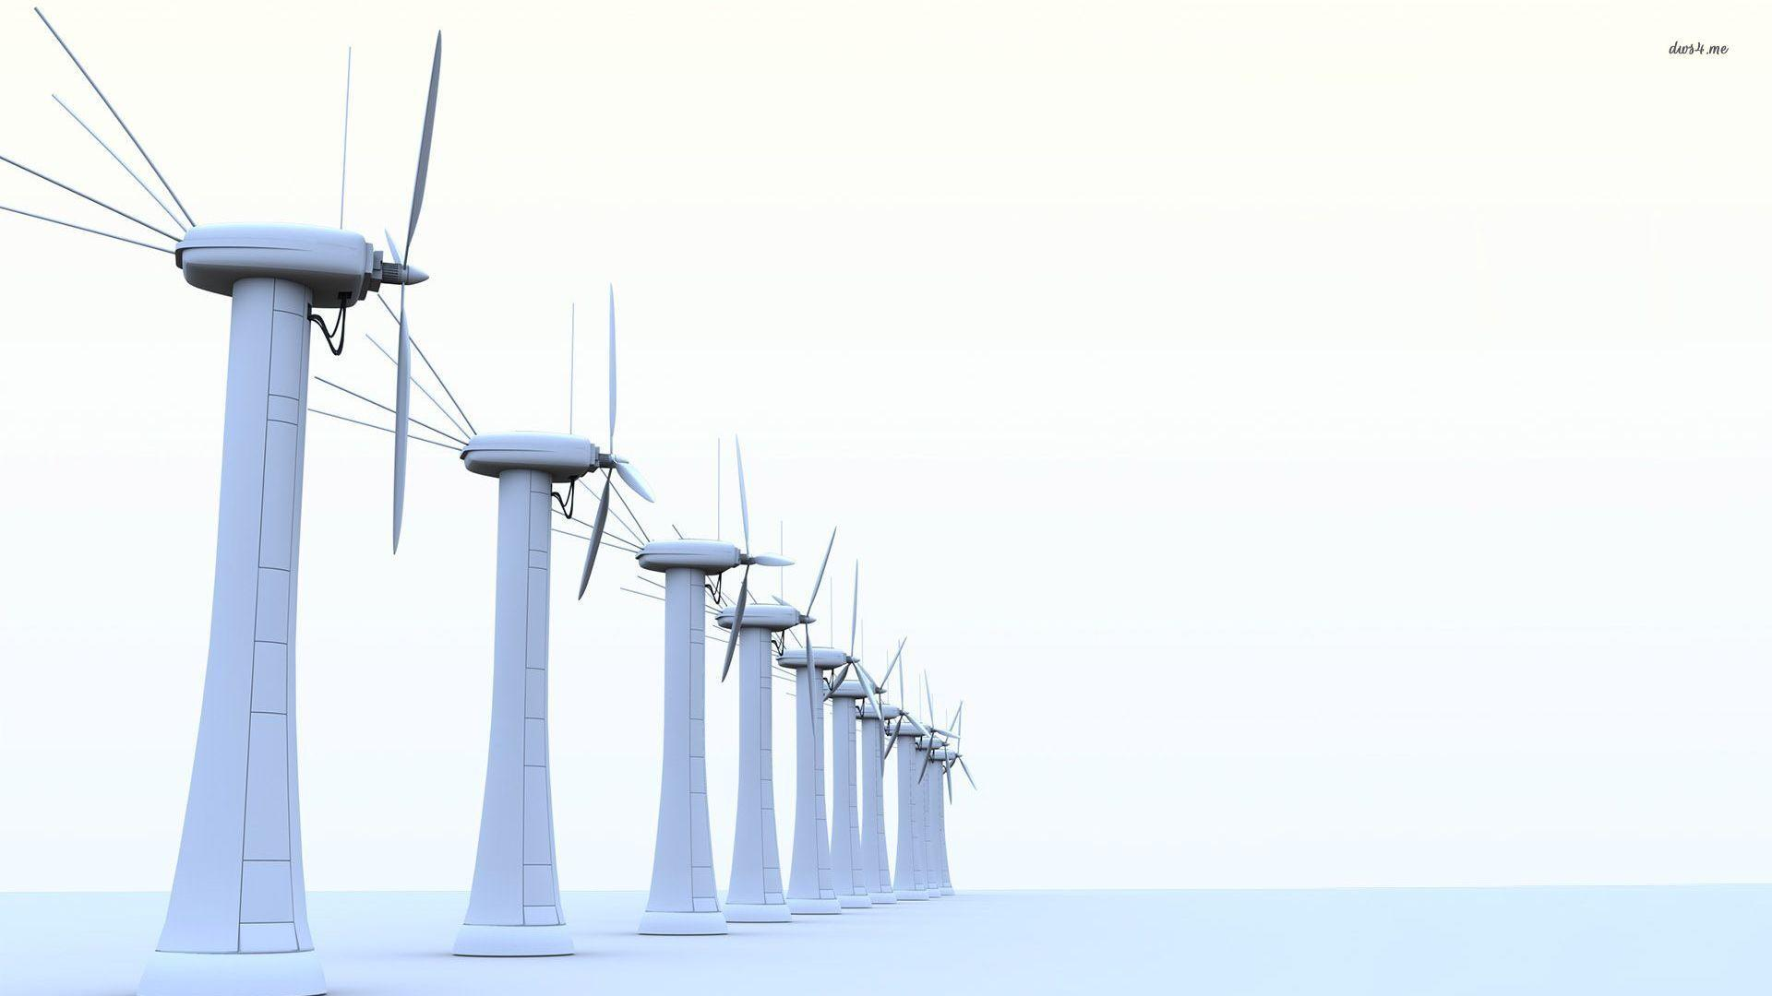
Energy Storage for a Wind Park in Isolated Operation Mode
Group Work Presentation (S01b)

Slide 2
Contents
1. Characteristics
1.1 Intermittent Wind Power Generation
1.2 Storage Performance Characteristics
2. Requirements
3. Technologies
4. Cost Calculation

Slide 3
What is An isolated Wind Park and why it might be necessary?

Slide 4
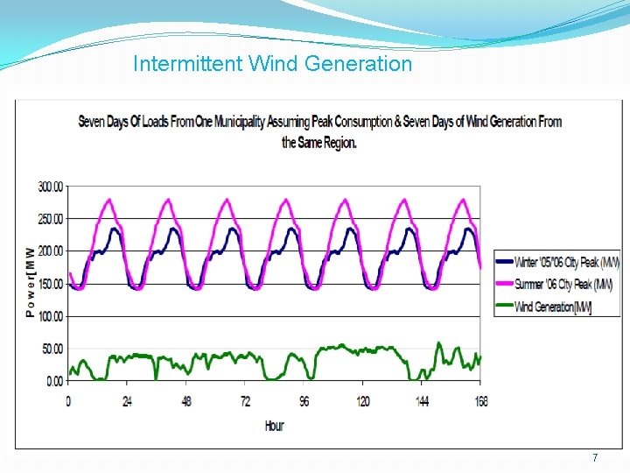
Intermittent Wind Power Generation
Wind produce sometimes heigher sometimes lower
Mismatch between supply and demand
High share of intermittent power generation threaten the frequency security due the absent of grid support
(1)

Slide 5
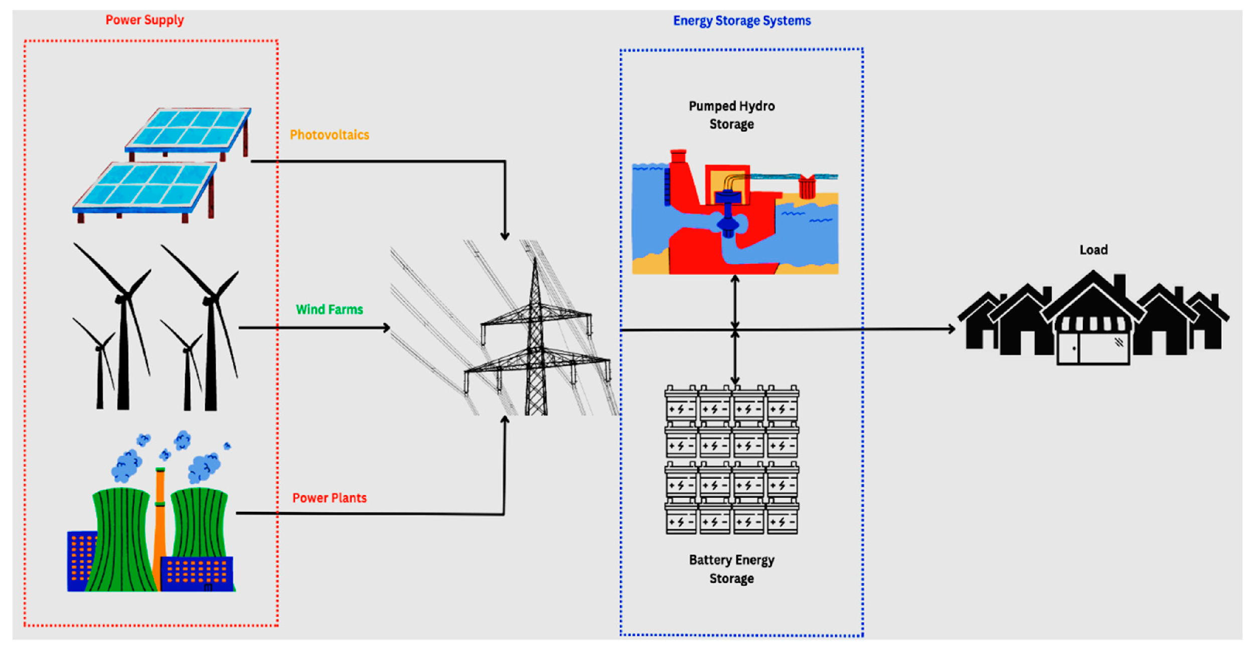
What is the importance of energy storage in isolated wind park?
(2)
Batteries help for controling voltage
ESS play the role of power balance, control,maintain the grid frequency and voltage stability
ESS give power even when wind is absent

Slide 6
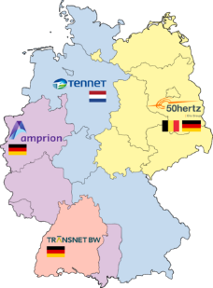
Characteristics Primary control (Prevents frequency collapse to cover windpark)
Response time: how quickly ESS react to changes in Power demand or suplly Essential for frequency stability in isolated grids (30sec– 15min)
Power capacity: maximum rate at which storage can charge or discharge energy
Energy capacity: affects how long the system can supply energy when wind is low
Efficiency: e.g Lithium-Ion Battery efficiency between 90-95%
Cycle life:number of charge/discharge cycles (Lithium-Ion battery more then 5000 cycles)

Slide 7
Characteristics secondary control (Restore frequency)
Response time: how quickly ESS react to changes in Power demand or suplly Essential for frequency stability in isolated grids (0–30 sec)
Power capacity: maximum rate at which storage can charge or discharge energy
Energy capacity: moderate
Efficiency: e.g Flywheel efficiency over 85%
Cycle life:number of charge/discharge cycles (Lithium-Ion battery more then 5000 cycles)

Slide 8
Characteristics Tertiary control (Reserve restoration, economic dispatch)
Response time: how quickly ESS react to changes in Power demand or suplly Essential for frequency stability in isolated grids (15min– Hours)
Power capacity: maximum rate at which storage can charge or discharge energy
Energy capacity: High
Efficiency: e.g pumped hydro storage efficiency over 70-85%
Cycle life: number of charge/discharge cycles (Lithium-Ion battery more then 5000 cycles)

Slide 9
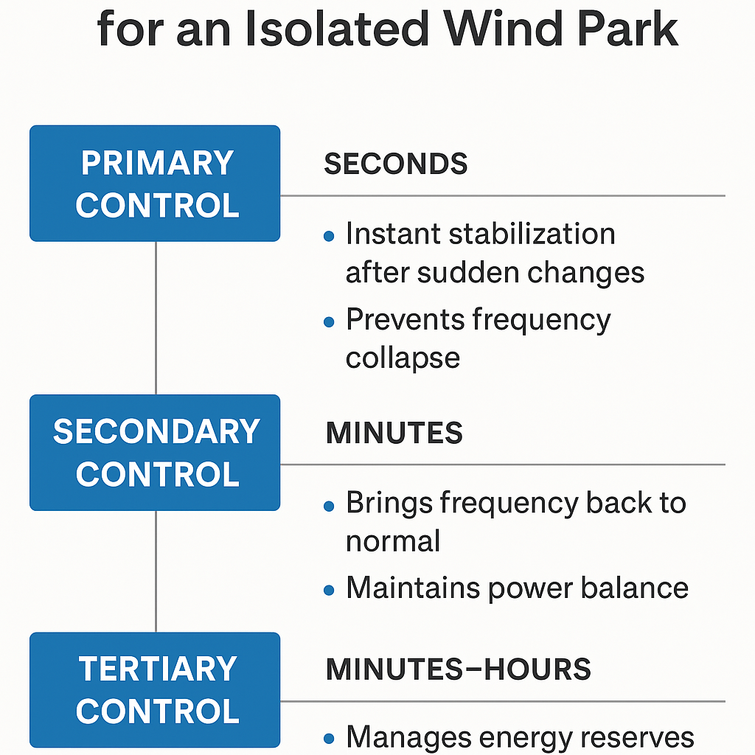
to ensure grid stability in the absence of a central power grid.

Slide 10
Technologies
Shortlisted Battery Storage Technologies
Lithium-Ion (Li-ion)
Pros: High energy density, fast response, mature technology
Cons: Fire risk, thermal runaway, lower life cycle vs flow
Best For: General purpose, high energy and power
Vanadium Redox Flow Battery (VRFB)
Pros: Long life cycle (>15,000 cycles), deep discharge, scalable
Cons: Lower energy density, higher upfront cost
Best For: Long-duration storage, isolated systems with many cycles
Sodium-Sulfur (NaS)
Pros: High energy density, good for long-duration storage
Cons: Operates at 300°C+, safety risks, complex thermal management
Best For: Medium- to long-duration industrial islanded applications

Slide 11
Cost Calculations & Sensitivity Analysis

Slide 12
Cost Calculations
Assumptions (for 10 MW Windpark)
Storage Requirement: 6 hours autonomy → 60 MWh capacity
Discharge Power: 10 MW (must match peak load)
Storage Duration: 6 hours
System Lifetime: 15 years
Electricity rate: 0.01 €/kWh
Capital Cost: 0.04
Cycles/Day: 1

Slide 13
Cost Calculations
Cost Calculation Parameters
Storage properties | unit | Li-Ion | Redox-Flow | lead-acid | NaS
charge efficiency | - | 0.97 | 1 | 0.9 | 1
discharge efficiency | - | 0.97 | 0.75 | 0.94 | 0.8
Maximum DOD | - | 0.9 | 0.95 | 0.8 | 1
capacity cost (storage only) k_E | €/kWh | 300 | 400 | 100 | 400
cost for BMS k_BMS | €/kWh | 30 | 50 | 10 | 20
converter cost k_P | €/kW | 100 | 100 | 100 | 100
n_max at DOD | - | 5000 | 10000 | 1500 | 3000
calendar life L_c | years | 15 | 15 | 10 | 15
selfdischarge per d | / day | 0.005 | 0.0001 | 0.005 | 0.0005
Cost for repair and maintenance | / year | 0.01 | 0.01 | 0.01 | 0.01

Slide 14
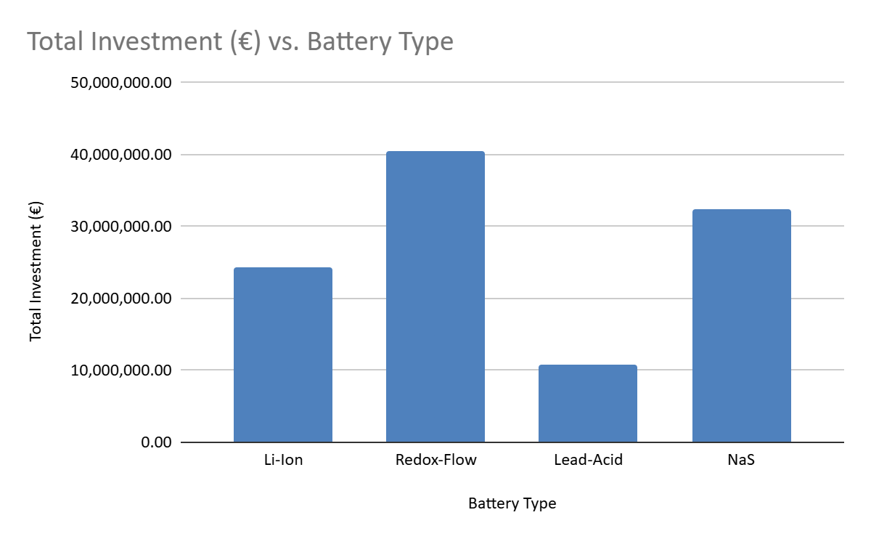
Cost Calculations
Result Comparison

Slide 15
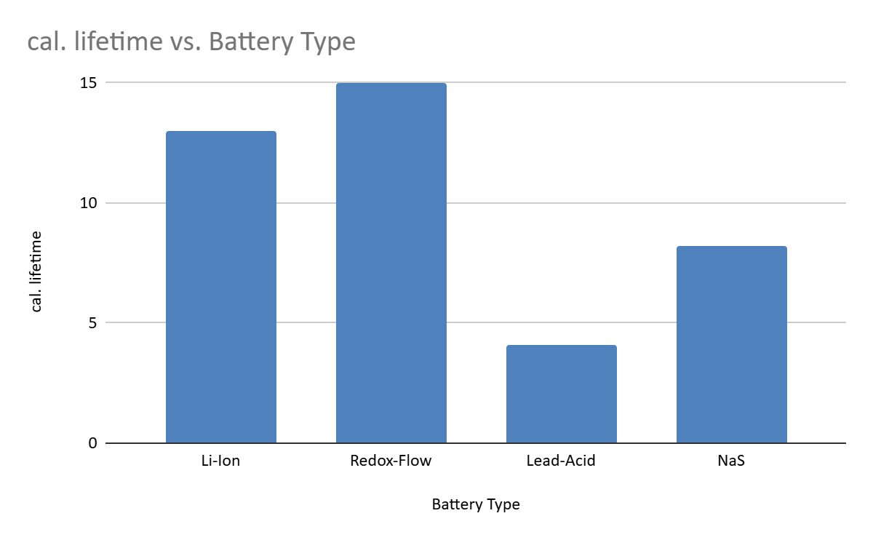
Cost Calculations
Result Comparison

Slide 16
Conclusion
Final Recommendation: VRFB (Vanadium Redox Flow Battery)
Reason | Justification
High cycle life | Surpasses 12,000 full cycles, ideal for frequent wind fluctuations
Deep discharge | 100% DoD possible without degradation
No risk of thermal runaway | Safer in isolated mode with minimal fire risk
Modular scaling | Easy to expand system with load/wind growth
Independent power and energy scaling | Separate sizing of power (MW) and energy (MWh) components

Slide 17
References : (1):https://th.bing.com/th/id/R.091226d9998a0cb19a8c94c9df602978?rik=9KLUt%2bMAen%2bp0Q&riu=http%3a%2f%2fslidetodoc.com%2fpresentation_image_h%2f2e4c17cc6d31a9c0c058e9934c378a10%2fimage-7.jpg&ehk=a9N7lvtB%2f38EtDhNesStY2HgDM86SkedNrwRuomqcDg%3d&risl=&pid=ImgRaw&r=0 (2): https://encyclopedia.pub/media/item_content/202302/63eae87173a01energies-16-01415-g006.png

